Slide 1
Exploratory Data Analysis G2M Case Study
21-May-2022

Slide 2
Agenda
Objectives
Summary of Data
Exploratory Data Analysis
Recommendations

Slide 3
Objective
Data Understanding
Forecast the future profits
Identifying the right cab company for making investment

Slide 4
Data Summary
Two Cab Companies: Pink and Yellow
Timeframe of the data: 2016-01-31 to 2018-12-31
359,392 observations and 14 variables in 4 data sets

Slide 5
Assumptions
Outliers in Price Charged and Cost of Trip are not considered due to the lack of details of trips
Profits are assumed to be the difference between Price Charged from Cost of Trip, other factors are not considered
Number of customers is assumed to be the number of transactions placed
Assume the number under the date of travel column corresponds to the consecutive dates from 2016 to 2018

Slide 6
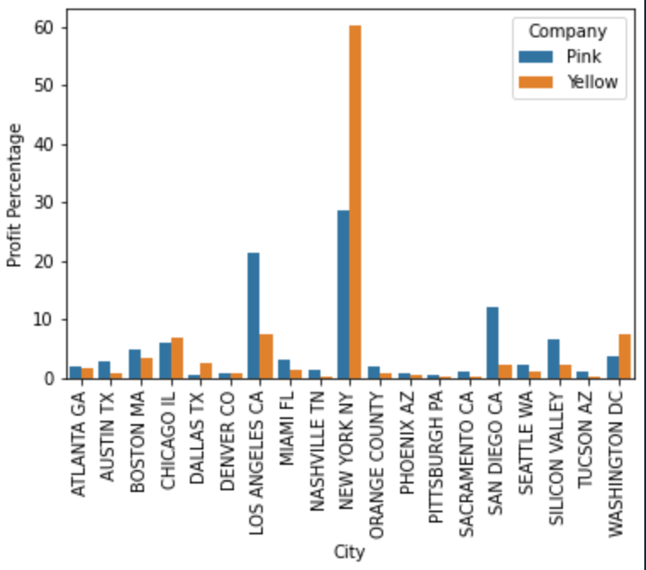
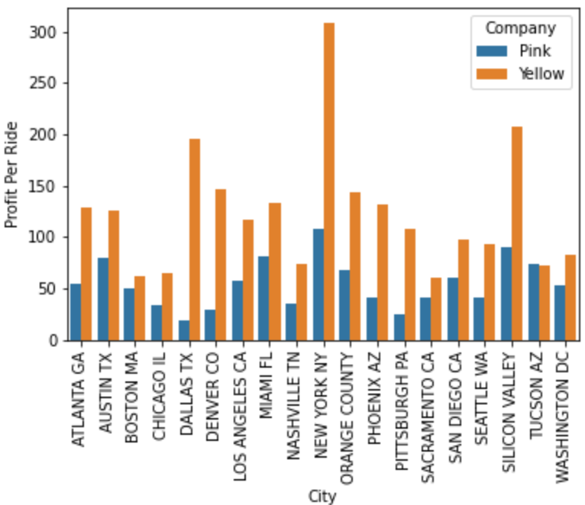
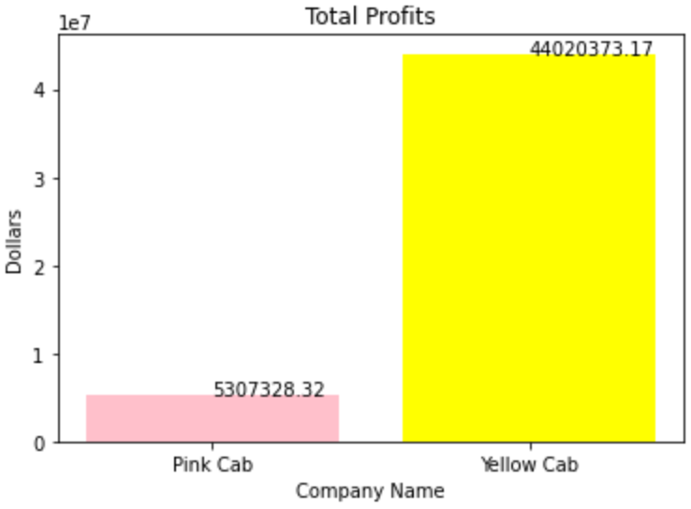
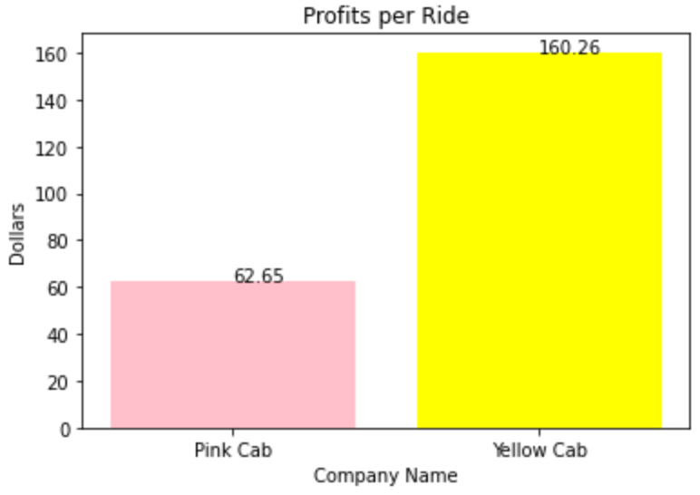
Profit Analysis
Yellow Cab Company has a higher total profits and profits per ride
Yellow Cab Company gains more profits across cities
Pink Cab Company gains mostly its profits in Los Angeles and San Diego

Slide 7
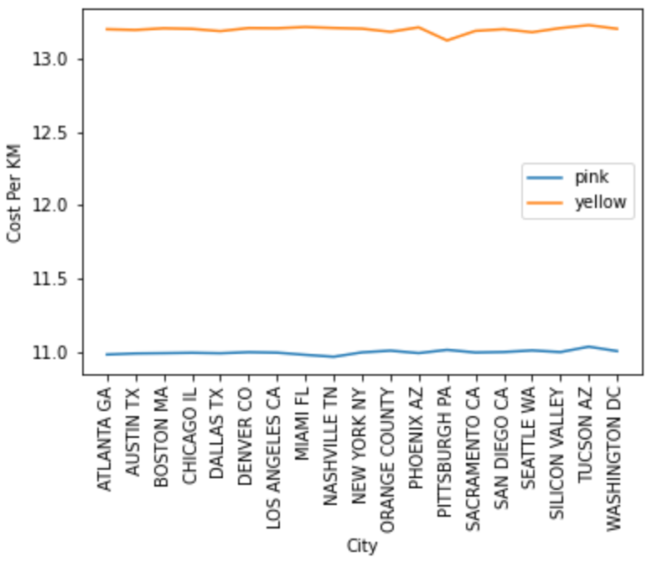
Cost Analysis

Slide 8
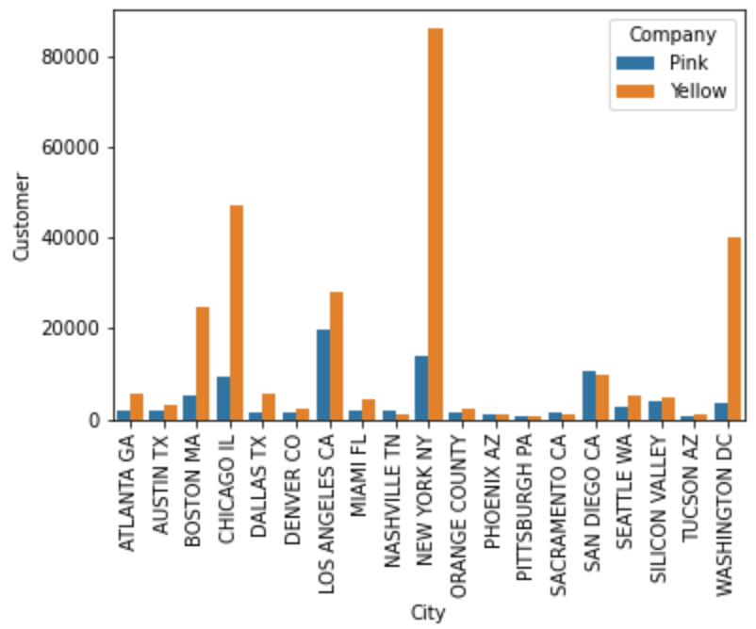
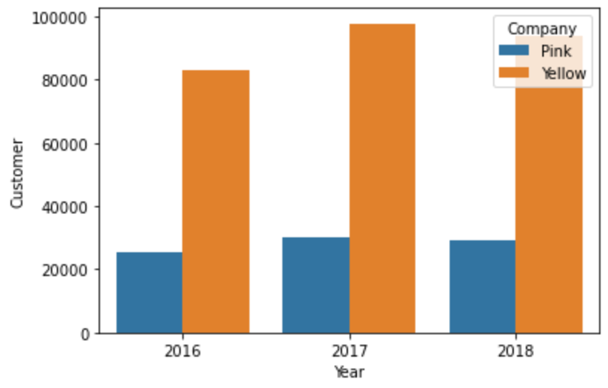
Customer Analysis
Yellow Cab Company dominates the market
Pink Cab Company has more customers in several cities
The trend is stable with slight decrease in 2018

Slide 9
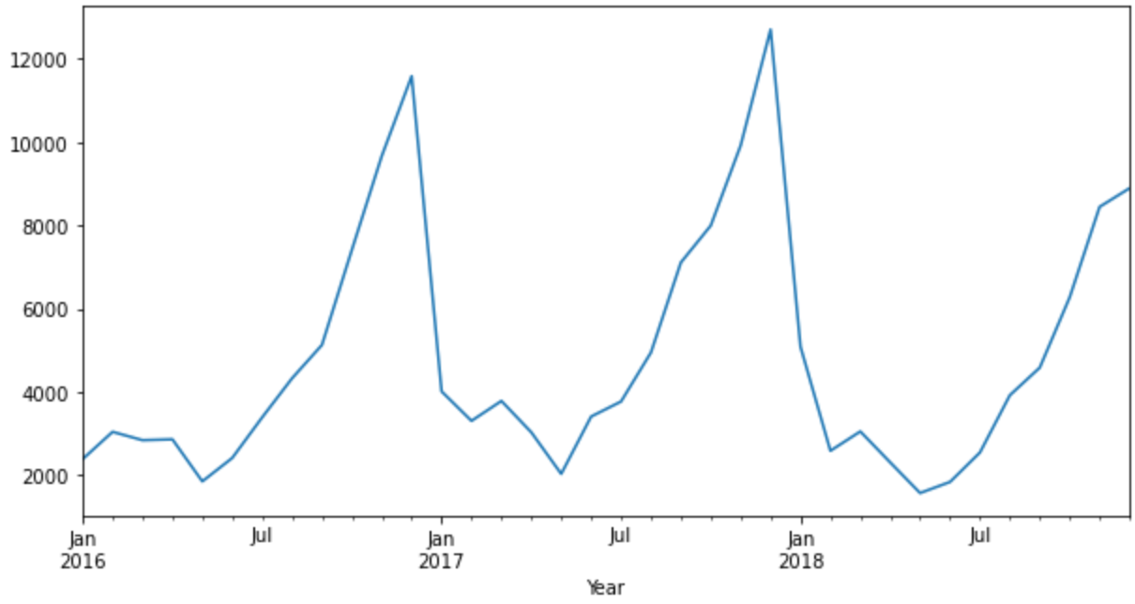
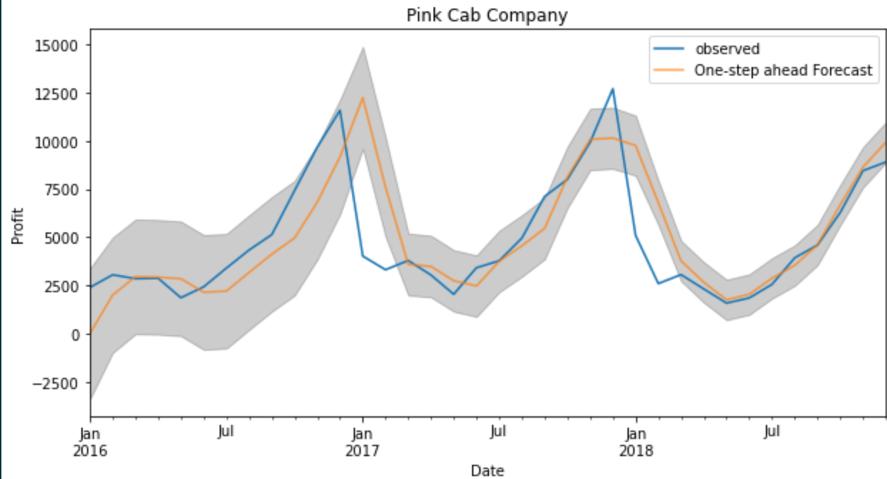
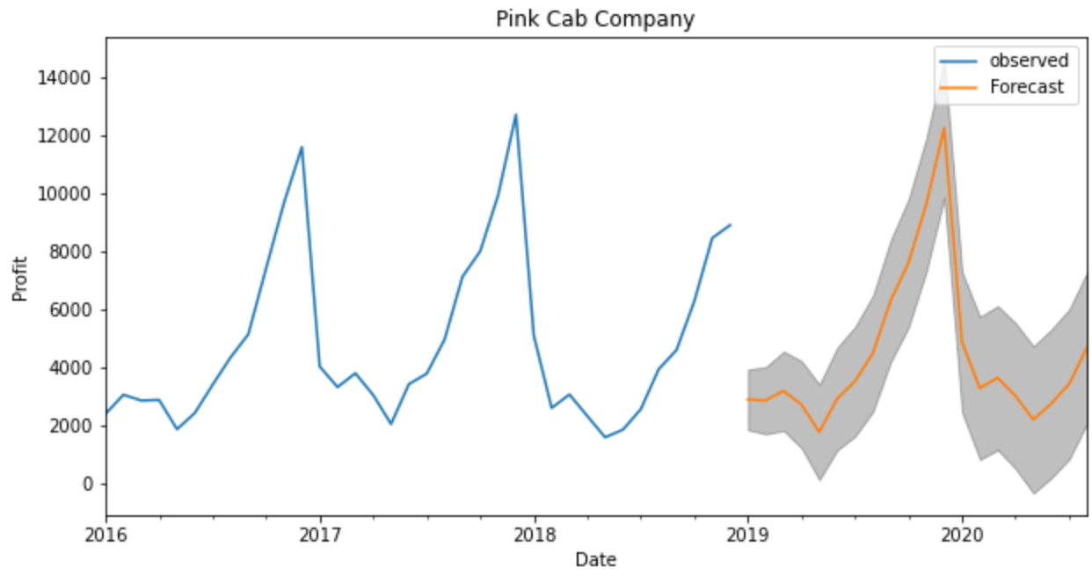
Forecasts
Pink Cab Company gains more profits at the end of each year and less profits at the beginning of each year
Forecasts to gain more total profits in the next two years

Slide 10
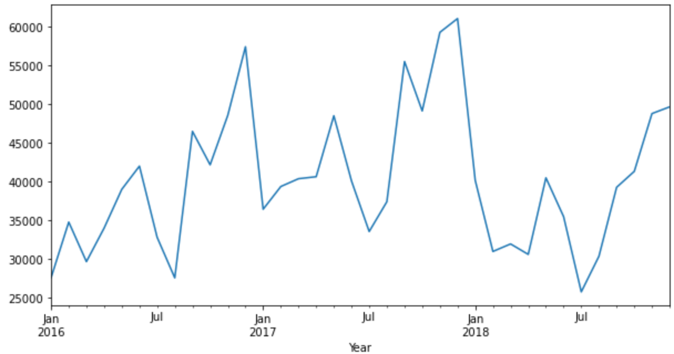
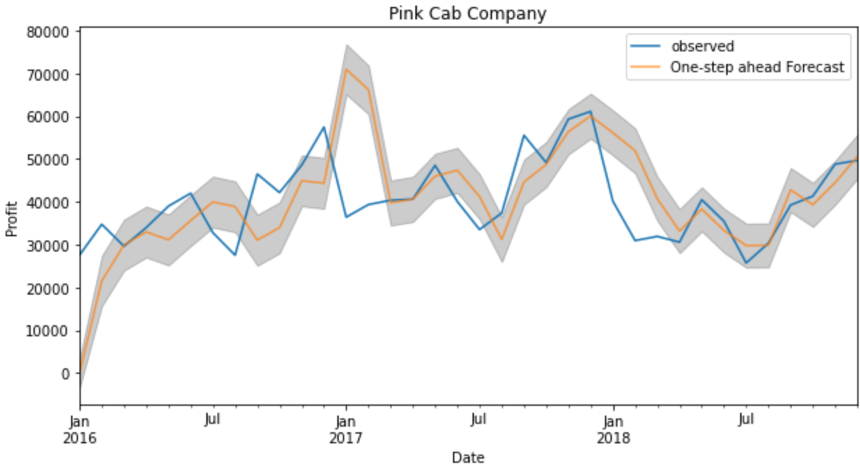
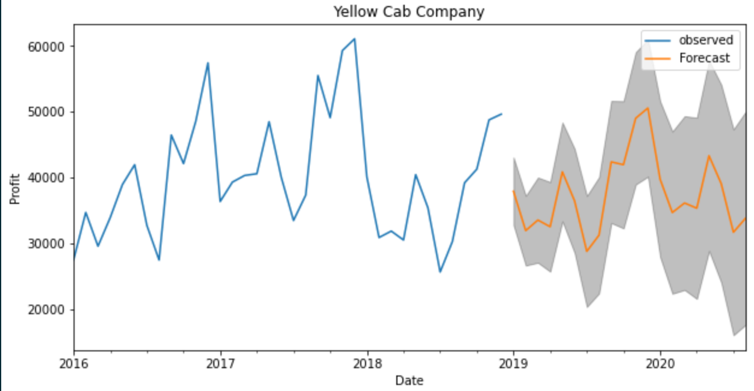
Forecasts
Yellow Cab Company shows a decreasing trend in the future two years

Slide 11
Summary
Average Profits: Yellow Cab Company has an overall higher total profits than the Pink Cab Company
City Wise Profits: Pink Cab Company gains mostly its profits from two major cities, and Yellow Cab Company gains mostly from one
Customer Reach: Yellow Cab Company has a higher customer reach of 15 cities, whereas Pink Cab Company has in 4 cities
Future Trend: Both Companies show more profit gains at the end of each year, and Yellow Cab Company shows a potential decrease in future trend, while Pink Cab Company shows a higher peak in total profits gain
Cost: Overall Yellow Cab Company has a higher costs per kilometers travelled than the Pink Cab Company

Slide 12

Recommendation
Yellow Cab Company is better and more stable for long term investment

